Slide 1
Spring dependency checking with @Required Annotation (Include RequiredAnnotationBeanPostProcessor)
Spring’s dependency checking in bean configuration file is used to make sure all properties of a certain types (primitive, collection or object) have been set.
In most scenarios, we just need to make sure a particular property has been set, but not all properties..
For this case, you need @Required annotation

Slide 2
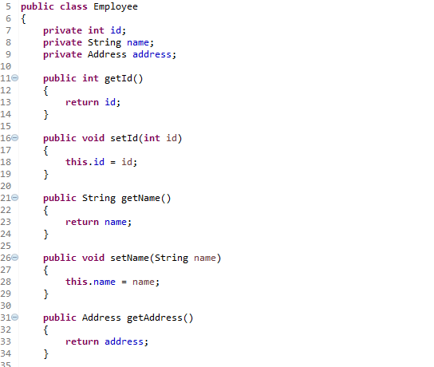
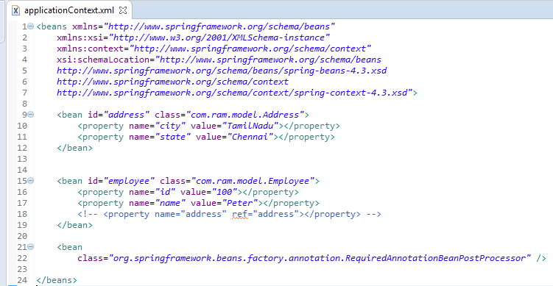
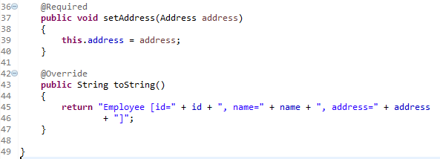
Spring dependency checking with @Required Annotation (Include RequiredAnnotationBeanPostProcessor)
A Employee object, apply @Required in setAddress() method to make sure the person property has been set.
Simply apply the @Required annotation will not enforce the property checking, we also need to register an RequiredAnnotationBeanPostProcessor to aware of the @Required annotation in bean configuration file.
The RequiredAnnotationBeanPostProcessor can be enabled by Including ‘RequiredAnnotationBeanPostProcessor’ directly in bean configuration file.

Slide 3
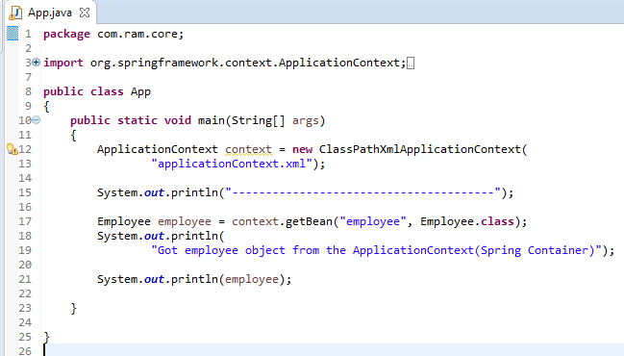
Spring dependency checking with @Required Annotation (Include RequiredAnnotationBeanPostProcessor)

